Slide 1
Driver Drowsiness Detection System
CSE 495
Preliminary Meeting – 1st Presentation
Yakup Talha Yolcu
Project Advisor : Yrd. Doç. Dr. Burcu Yılmaz
October 2022

Slide 2
Content
Project Definition
Project Design and Timeline
Project Requirements
Success Criterias
Resources and References

Slide 3
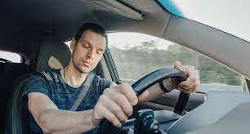

Project Definition
In this project we have a system that gives an alarm if driver is detected as drowsy.
Drowsiness detection works on two different situations :
If driver is closing their eyes for an amount of time
If driver can’t keep their head up for an amount of time (moves the head to any side without turning head)
When driver is detected as drowsy

Slide 4
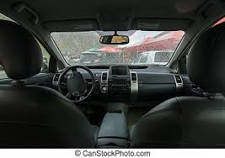
Project Design Plan and Timeline
If driver is detected as drowsy, rasperry pi sends a notification to the phone and alarm rings.
Camera and
Rasperry Pi
Alarm and mobile phone
24.10-06.11 | 07.11-18.12 | 02.01-15.01
Get ready the hardware (Rasperry pi, camera etc…) Determine datasets to be used | Installing needed libraries to the hardware. Developlment of mobile app Training models and compare models with each other to determine success rates. | Test the system with different drivers. Determine success rate of the project

Slide 5
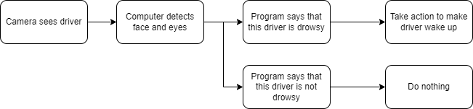
Project Design and Timeline
Different techniques can be used:
Machine Learning and Image Processing options:
OpenCV, Keras and Tensorflow (Sequential-InceptionV3)
OpenCV, YOLOv5 and Pytorch (YOLO Model)
Hardware Options:
Rasperry Pi
Nvidia Jetson Nano

Slide 6
Project Requirements - 1
In this project, we will have these requirements:
Face and Eye detection algorithm should be developed with Machine Learning and Image Processing techniques.
A large dataset should be used to train algorithm with these classifications: closed eye, open eye, not yawning face, yawning face
Face should be recognized on video stream
Detected face should be given as input to the trained algorithm.
If this face is detected as drowsy, alarm should ring and a notification sent to the mobile app.

Slide 7
Project Requirements - 2
For face and eye detection, OpenCV library is required.
Keras and Tensorflow libraries is required to build classification model of the images to be trained.
An alarm sound is required to wake the driver up
A mobile application developed on Flutter language to send notifications to the selected persons.
A camera should be able to see the driver clearly.
Well classified dataset used to train model.
Raspberry Pi 4 Model B
Raspberry Pi Official Camera Module V2
Micro SD Card
Power Supply
HDMI Cord

Slide 8
Success Criteria
True prediction with rate of 90% drowsiness of driver.
Predicting the drowsiness of the driver in 5 seconds at max
10% reduction in accidents caused by drowsiness.

Slide 9
Resources and References
https://www.nauto.com/blog/introducing-driver-drowsiness-alerts (Drowsy driver in Project Definition page)
https://www.canstockphoto.com/the-view-inside-the-empty-car-the-54421487.html (Empty car inside view used in Project Design Page)
https://dergipark.org.tr/en/download/article-file/19838 (Analysis of Traffic Accidents in Turkey, Islim Sungur, Recep Akdur , Birgül Piyal)
Poursadeghiyan M, Mazloumi A, Nasl Saraji G, Baneshi MM, Khammar A, Ebrahimi MH. Using Image Processing in the Proposed Drowsiness Detection System Design. Iran J Public Health. 2018 Sep;47(9):1371-1378. PMID: 30320012; PMCID: PMC6174048.
Identification of Driver Drowsiness Using Image Processing K.Praveen Kumar, Srinivasa Rao Thamanam, M. Naresh Kumar
Gilbile, P., Bhore, P., Kadam, A., Balbudhe, K. (2019). Driver’s Drowsiness Detection Using Image Processing. In: Pandian, D., Fernando, X., Baig, Z., Shi, F. (eds) Proceedings of the International Conference on ISMAC in Computational Vision and Bio-Engineering 2018 (ISMAC-CVB). ISMAC 2018. Lecture Notes in Computational Vision and Biomechanics, vol 30. Springer, Cham. https://doi.org/10.1007/978-3-030-00665-5_70

